Slide 1


Introduction to Year 1

Slide 2

Phonics
Ms. Lee – Phonics Lead

Slide 3

Timetable of the Day
Gates open and classroom doors open at 8:30am ​
Children complete Early Morning Work.
Registration at 8:40am ​
Learning Time 8:40 am – 9:00am ​
Whole school Collective Worship at 9:00am – 9:20am
Break 10:30am - 10:45am ​
Learning Time 10:45am - 12:10pm​
Lunch 12:10pm – 1:10pm​
Learning Time 1:10pm – 3:10pm ​
Home Time 3:10pm (collect the children at the door)​.
We begin our learning promptly at 8:40 a.m., so it is important that all children arrive on time and ready to learn.

Slide 4




English
Maths
In English, we focus on a range of different texts and the children produce a variety of different pieces of writing.
We follow the Oak Academy scheme.
The topics we will be covering:
Counting
Composition of numbers
Addition & Subtraction
Money
Time

Slide 5


Religious Education
Throughout the year, the children will learn about Christianity along with all the other major religions.
Autumn 1: The Gospels
Autumn 2: Incarnation
Spring 1: Judaism
Spring 2: Salvation
Summer 1: Judaism
Summer 2: Creation

Slide 6
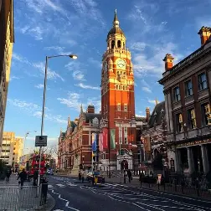

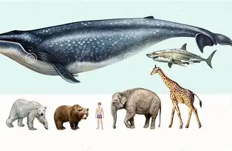

Humanities and Science
We follow the Kapow curriculum for our foundation subjects.
Throughout the year, children explore topics such as the What is it like here? and How have explorers changed the world?, while in Science they develop their understanding of Seasonal Changes and Comparing Animals through engaging, hands-on learning experiences.

Slide 7
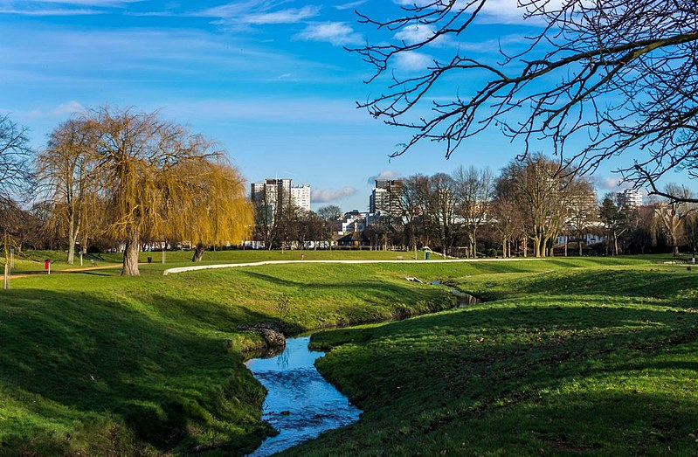
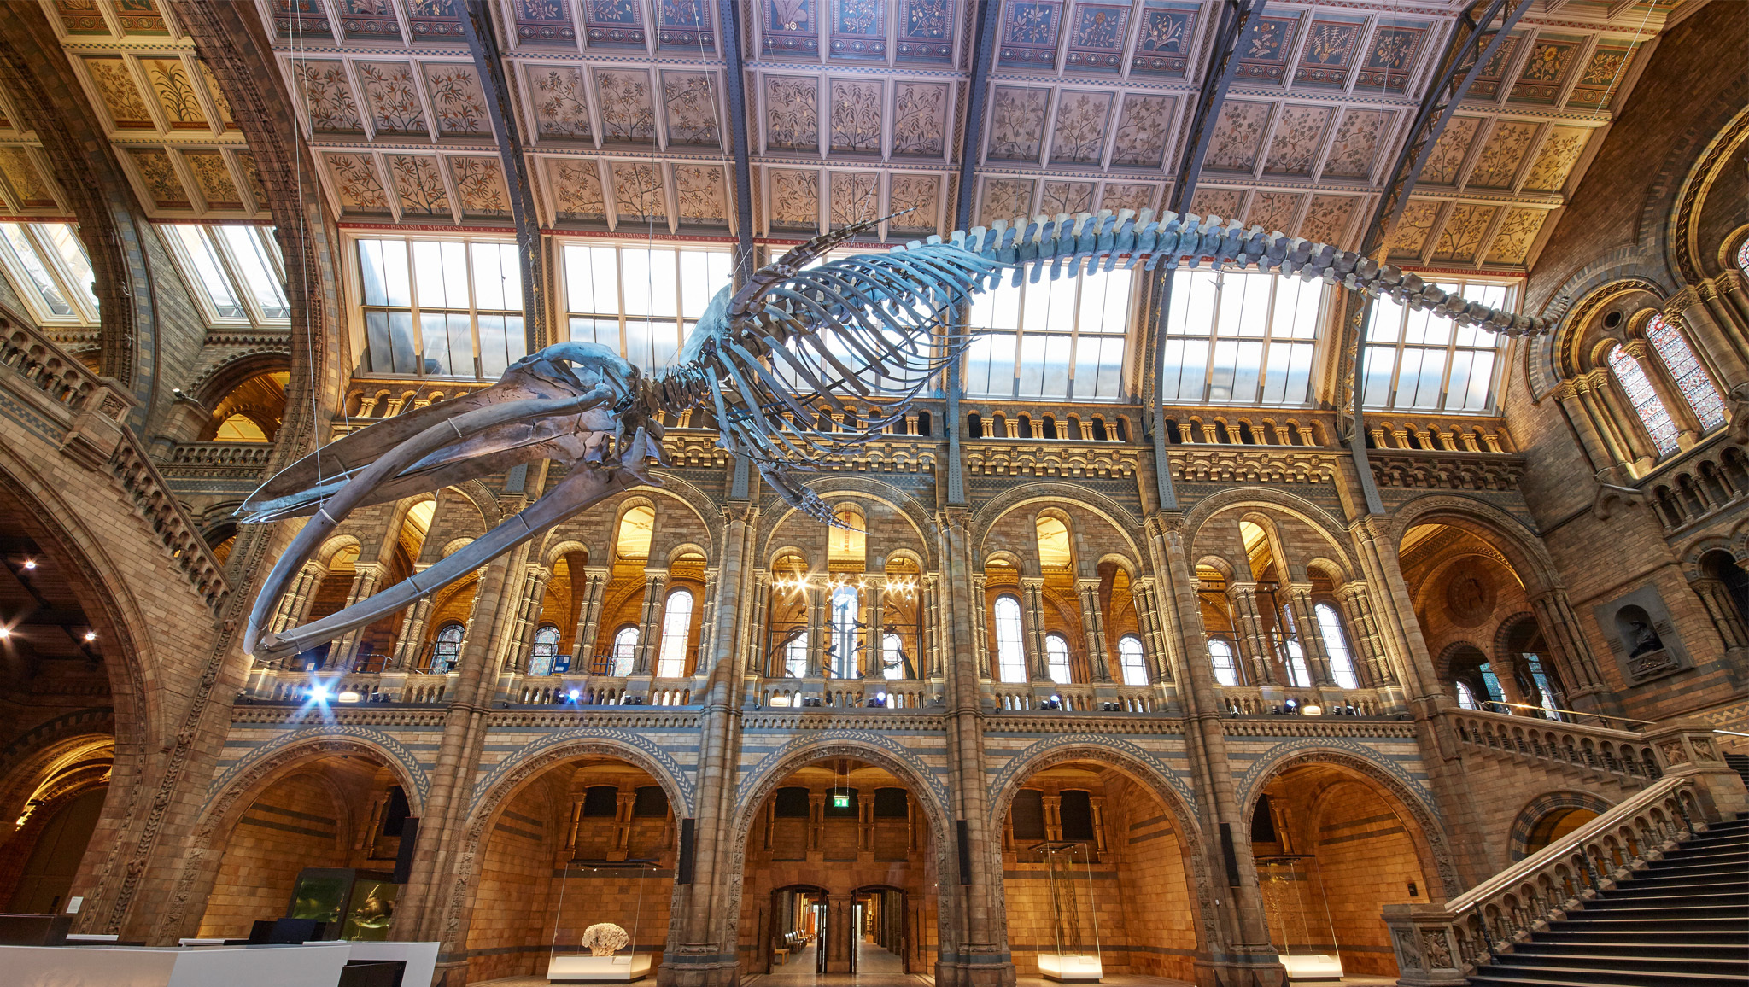
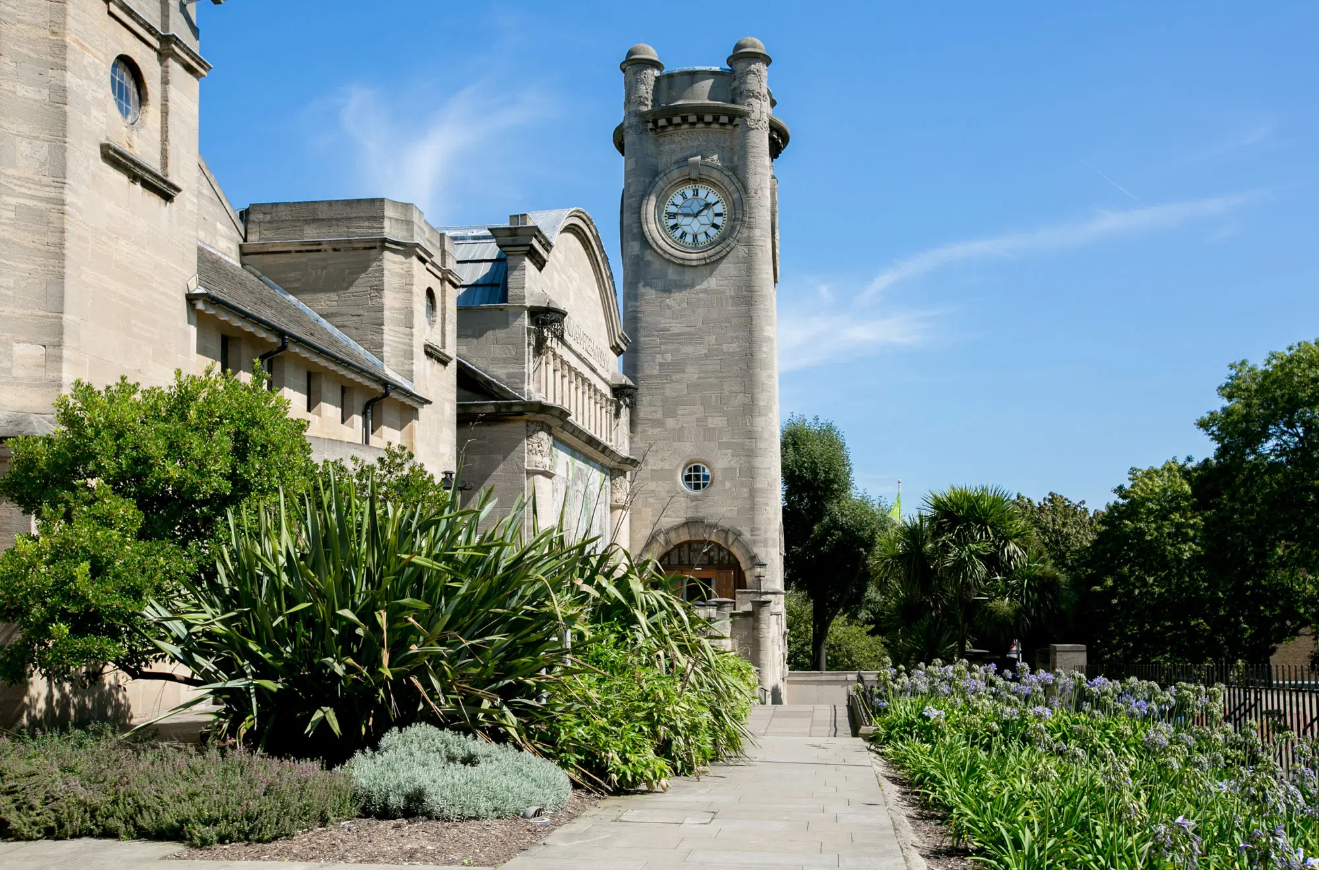

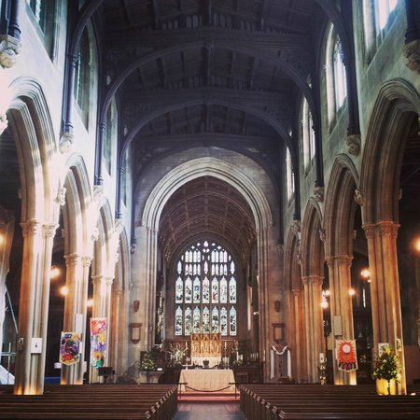
Trips
To enhance and enrich our learning, we organise a range of educational visits both within our local community, including trips to London. These experiences help bring learning to life and provide valuable real-world opportunities for exploration.

Slide 8

Home Learning
Home learning will be sent out every Tuesday and expected back the following Monday.
It will consist of Maths, English or a Learning Task
Reading – please read with your child as much as possible. It is advised that a child should be listened to for at least 20 minutes a day 5 times a week.

Slide 9

School Uniform
School Uniform
PE Kits
School sweatshirt or cardigan, grey skirts or grey trousers/shorts, and a white polo shirt.
In the summer, children may wear a dark red check dress.
Shoes must be sturdy black flat school shoes.
All children should have a plain white T-shirt, plain black shorts and a pair of trainers.
Warm black or grey track suit bottoms and a fleece top can be worn for outdoor games in the colder months.
Please mark your child’s uniform as we get a lot of lost uniform.

Slide 10
Thank you and we look forward to a very successful year full of enjoyment and learning!

