Slide 1
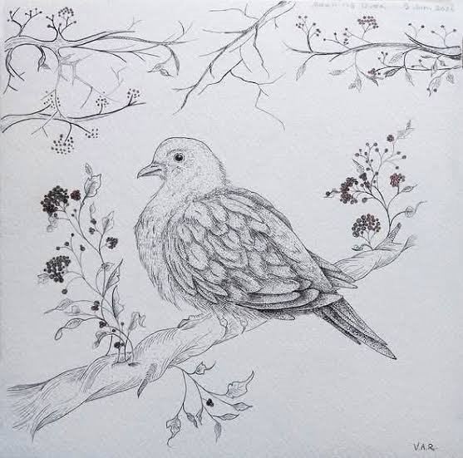
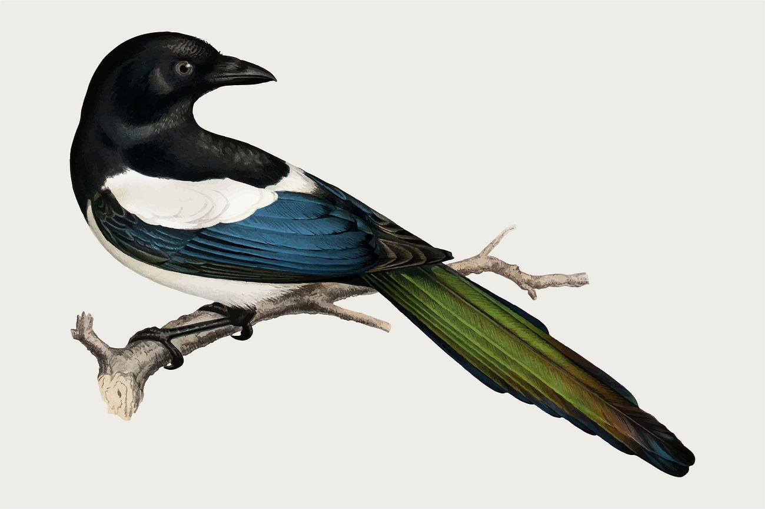
Welcome to Year 2

Slide 2
What is the most important thing you can do to help your child flourish?
Play board games and do jigsaws
Talk
Attend school every day
Read with your child daily
A good bedtime routine and good night’s sleep
Support your child to develop healthy eating. Introduce your child to cooking
Set limits on screen time and use parent controls
Keep active – lots of trips to the park

Slide 3

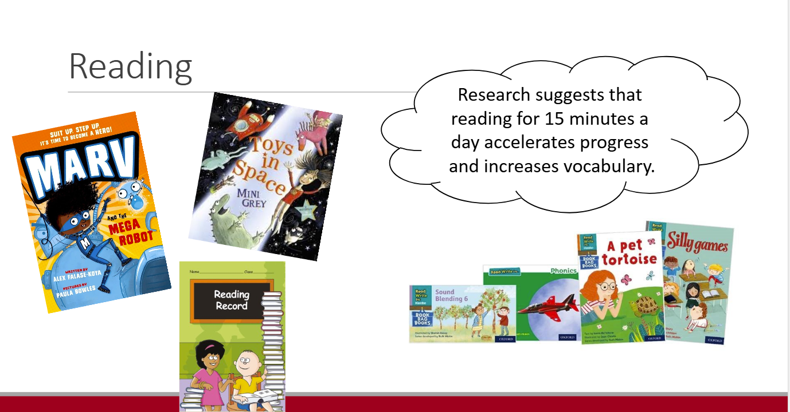

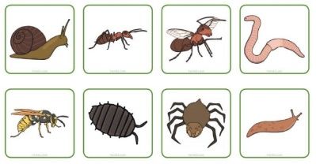

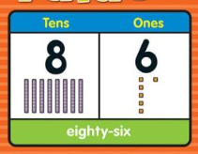
Year 2!
Home learning
Home learning will be sent home every Tuesday. It will include activities linked to:
Spelling
Maths
Reading or Handwriting
We encourage children to complete their homework carefully and independently where possible. Your support and encouragement at home will make a real difference to their learning.
Reading for Pleasure
We want to encourage all children to develop a love of reading. Each child will be able to choose a book from our classroom library to take home and enjoy. This book is for reading for pleasure and allows children to explore books and stories that interest them.
Alongside their chosen classroom book, children will also receive a phonics reading book, which will be sent home in a plastic wallet.
Learning behaviour and expectations
Our focus for the Autumn term:
An exciting retelling of Goldilocks and the Three Bears.
Fun science enquiries around topics such as habitats, mini beast habitats and materials.
Learning about place value, focussing on numbers to 100.
To prepare for Year 2 you should bring:
A labelled water bottle.
A school book bag as we don’t have much space for big rucksacks!
PE kit on PE days.
And finally, please make sure all of your uniform is labelled!!

Slide 4
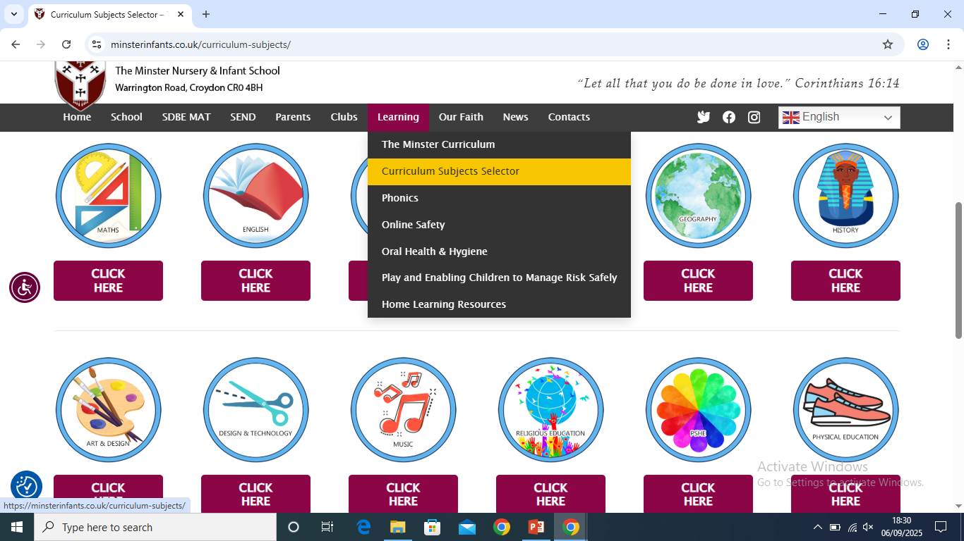
Year 2 Curriculum

Slide 5
Reading
In Year 2:
Read accurately most words of 2 or more syllables.
Read accurately and fluently (e.g. over 90 words per minute).
Sound out unfamiliar words with little hesitation.
Answer questions about the text, based on what is being said and done.

Slide 6

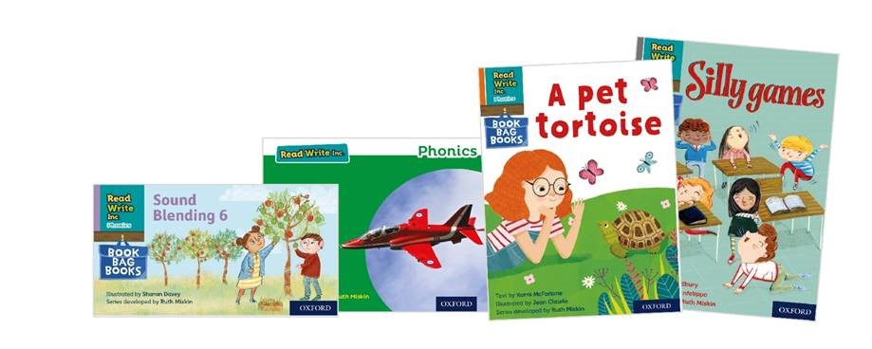

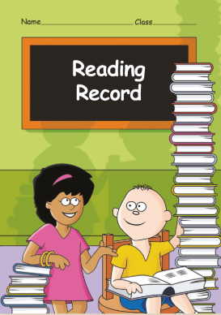
Reading
Research suggests that reading for 15 minutes a day accelerates progress and increases vocabulary.

Slide 7
Writing
Plan/Say aloud what to write using key words.
Re-read writing to check for sense.
Spell the common exception words accurately.
Use punctuation more accurately - including commas in lists, apostrophes.
Use expanded noun phrase to describe e.g. the blue butterfly.
Use different sentence types – e.g. command, question, statement, exclamation.
Use conjunctions – and, or, but, if, because, when, that.
Identify adjectives, nouns, verbs in sentences.
Use the horizontal and diagonal strokes to join some letters.

Slide 8
Maths
Pupils can partition 2-digit numbers in different ways. e.g. 23 = 20 + 3, 23 = 10 + 13
Recall addition and subtraction facts within 20
Adding and subtracting 2 digit numbers
Recall division and multiplication facts for 2, 5 and 10 times table
Use different coins to make the same amount (make 50p in different ways).
Tell the time on a clock to the nearest 15 minutes.
Identify ½, 1/3, ¼, 2/4 and ¾ of a number or shape and know that all parts must be equal

Slide 9
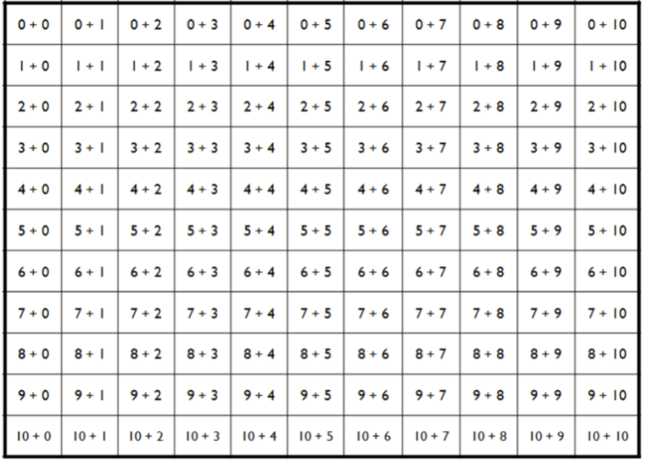
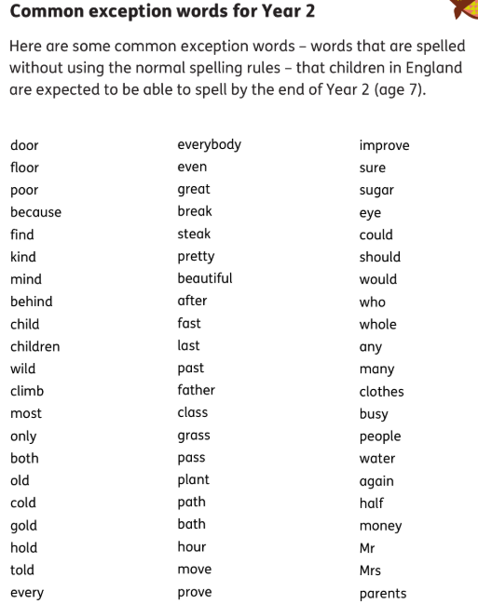
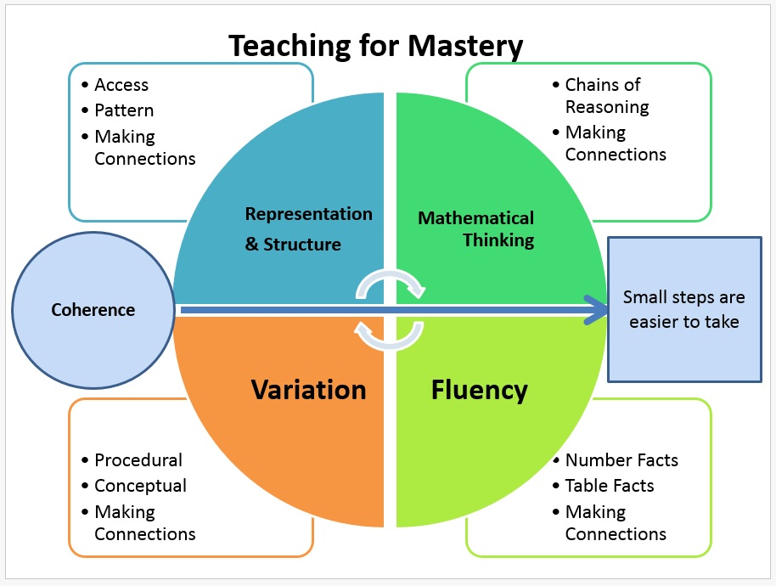
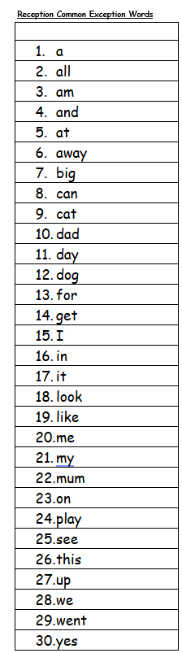
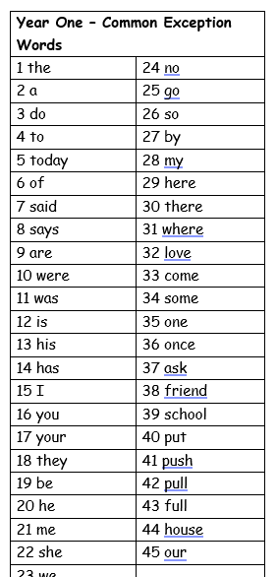
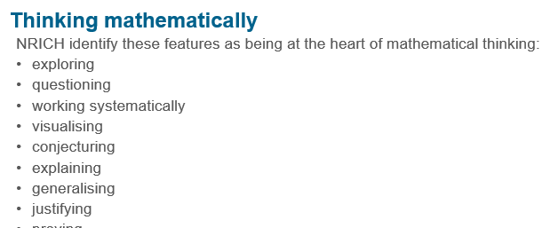
Key information

